Slide 1
Correlational Analysis of Twitter Sentiments and Intraday Stock Price Data
Sam Shazemi
Thimmaiah Honaganahalli

Slide 2
Hypothesis

Slide 3
Is there any relationship between twitter sentiments and stock price data?

Slide 4
Hypothesis support
Market prices are believed to be affected by hype and public perception
So it stands to reason that people’s thoughts expressed on one of the most actively used social media platforms can have a strong impact on the market.
For our analysis we will be analyzing Facebook stock prices for the a specific date.

Slide 5
Data Scraping And Cleaning

Slide 6
Sources of Data
GetOldTweets (https://github.com/Jefferson-Henrique/GetOldTweets-python)
BarCharts OnDemand API free intraday stock data

Slide 7


Procedure
The most difficult part of the process.
Required acquisition of over 150,000 tweets.
Tweets needed to acquired specifically during market hours.
Most tweet acquisition libraries have limitations on the data they provide.

Slide 8
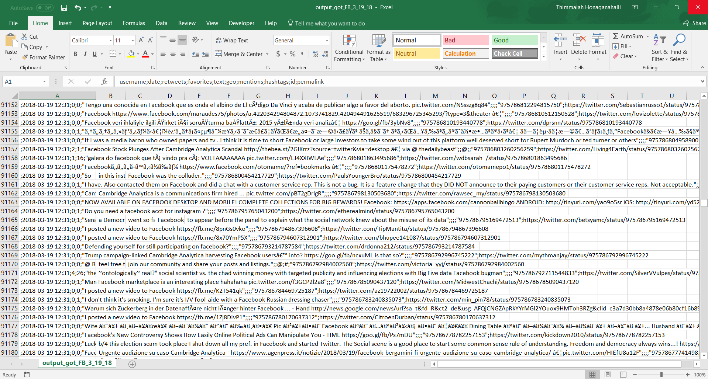
The experiment

Slide 9
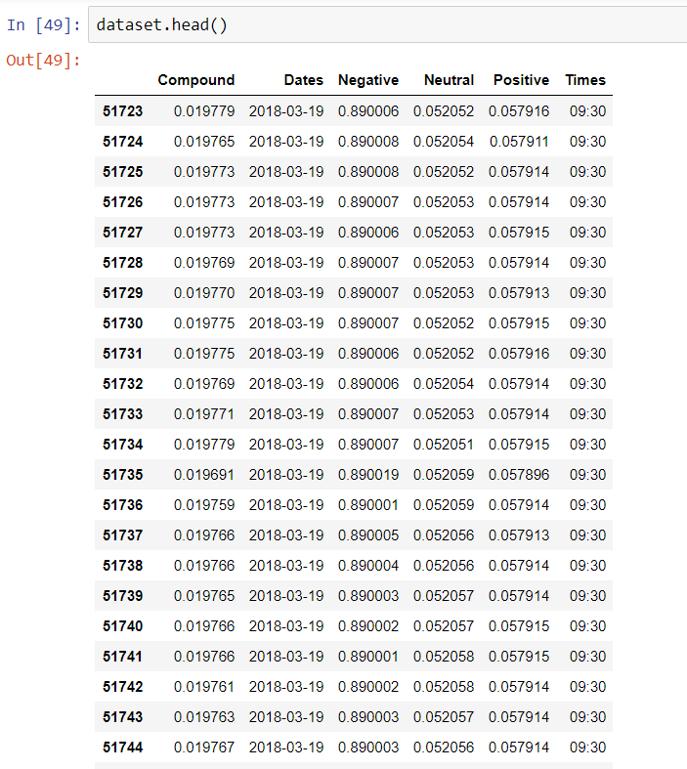
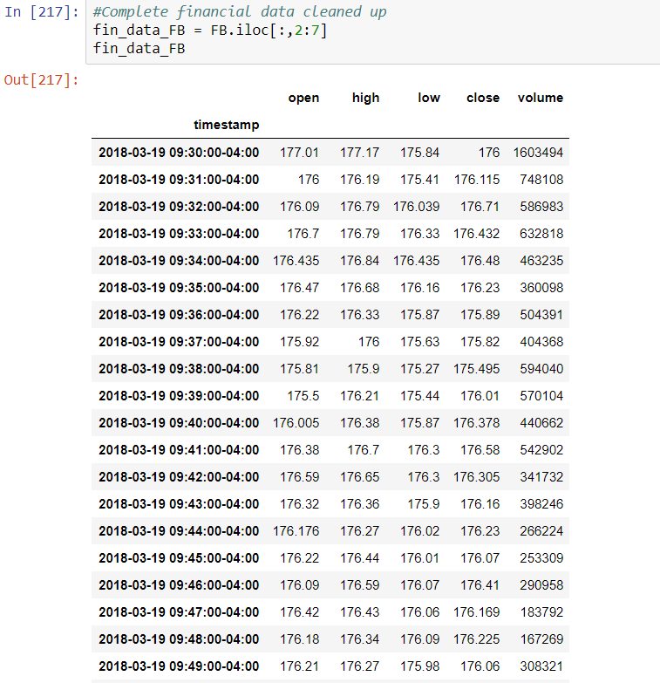

Slide 10
Data Analysis And Plotting

Slide 11
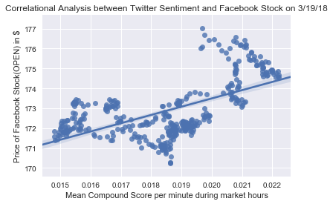
Procedure
We utilized the seaborn and scikit learn modules
The linregress method was utilized to perform the regression analysis.
Looking at the graphs a strong positive correlation is apparent.

Slide 12
Drawbacks to our analysis:
Limits to data scraping is the biggest problem.
The regression analysis is a rudimentary analysis and does not account for prior stock history.
By the time the analysis was conducted public sentiment of Facebook was already negative.
This is a correlational analysis and not necessarily a causational analysis.

Slide 13
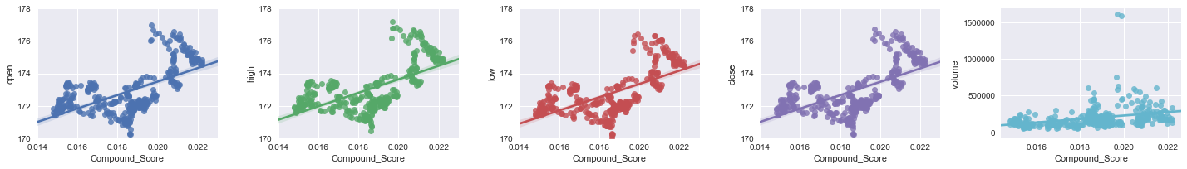
Conclusion
It is apparent with the data that we have acquired and the analysis conducted there is a strong correlation coefficient and a low standard error (r^2 = 0.592, std error = 28.27) in the data expressing the relationship between the stock price of Facebook and the sentiments expressed on twitter. However this is still a rudimentary analysis. Further testing with larger and more varied datasets(along with more effective statistical methods) would be required to effectively prove a causational relationship between twitter sentiment and stock data.

